Slide 1
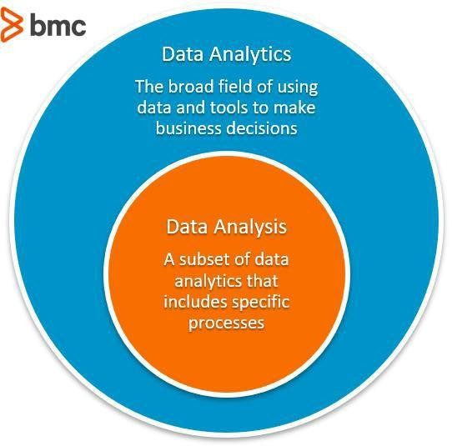
Data Analytics vs Data Analysis:
It’s a common misconception that data analysis and data analytics are the same thing. The generally accepted distinction is:
Data analytics is the broad field of using data and tools to make business decisions.
Data analysis, a subset of data analytics, refers to specific actions.
What is data analytics?
Data analytics is a broad term that defines the concept and practice (or, perhaps science and art) of all activities related to data.
Data that is raw, as-is, has no value. Instead, it’s what you do with that data that
provides value. Data analytics includes all the steps you take, both human- and

Slide 2
machine-enabled, to discover, interpret, visualize, and tell the story of patterns in your data in order to drive business strategy and outcomes.
What is data analysis?
Consider data analysis one slice of the data analytics pie. Data analysis consists of cleaning, transforming, modeling, and questioning data to find useful information. (It’s generally agreed that other slices are other activities, from collection to storage to visualization.)
The act of data analysis is usually limited to a single, already prepared dataset. You’ll inspect, arrange, and question the data.
A vital point of data analysis is that the analysis already captures data, meaning data from the past.
Example 1:
Almost every one of us has at least some little knowledge about the Share Market. Just think if you are a beginner and you want to start your trade with some profit there. Now say what you will do initially?
Most probably before starting trading you just try to examine the past trend records of the shares in the share market to understand what happened so far in order to frame your strategies to get more profit right? This kind of process is an example of Data Analysis.
After understanding the trend of the shares, now you may use different techniques to predict the future price trend of the shares, and based on that you buy some shares right? This is an example process of Data Analytics.
Differences Between Data Analytics vs Data Analysis

Slide 3
Data analysis is a procedure of investigating, cleaning, transforming, and training
of the data with the aim of finding some useful information, recommend conclusions and helps in decision-making. Data analysis tools are Open Refine, Tableau public, KNIME, Google Fusion Tables, Node XL and many more.
Analytics is utilizing data, machine learning, statistical analysis and computer- based models to get better insight and make better decisions from the data. Analytics is defined as “a process of transforming data into actions through analysis and insight in the context of organizational decision making and problem- solving.” Analytics is supported by many tools such as Microsoft Excel, SAS, R, Python(libraries), tableau public, Apache Spark, and excel.
Data Analytics and Data Analysis Comparison Table
Below is the comparison table Between Data Analytics and Data Analysis.
Basis for Comparison | Data Analytics | Data Analysis
Form | Data analytics is ‘general’ form | Data | analysis | is | a

Slide 4
 | of analytics which is used in businesses to make decisions from data which are data-driven | specialized form of data analytics used in businesses to analyze data and take some insights of it.
Structure | Data analytics consist of data collection and inspect in general and it has one or more users. | Data analysis consisted of defining a data, investigation, cleaning, transforming the data to give a meaningful outcome.
Tools | There are many analytics tools in a market but mainly R, Tableau Public, Python, SAS, Apache Spark, Excel are used. | For analyzing the data OpenRefine, KNIME, RapidMiner, Google Fusion Tables, Tableau Public, NodeXL, WolframAlpha tools are used.

Slide 5
Sequence | Data analytics life cycle consist of Business Case Evaluation, Data Identification, Data Acquisition & Filtering, Data Extraction, Data Validation & Cleansing, Data Aggregation & Representation, Data Analysis, Data Visualization, Utilization of Analysis Results. | The sequence followed in data analysis are data gathering, data scrubbing, analysis of data and interpret the data precisely so that you can understand what your data want to say.
Usage | Data Analytics, in general, can be used to find masked patterns, anonymous correlations, customer preferences, market trends and other necessary information that can help to make more notify decisions for business | Data analysis can be used in various ways like one can perform analysis like descriptive analysis, exploratory analysis, inferential analysis, predictive analysis and take useful insights from the

Slide 6
 | purpose. | data.
Example | Let say you have 1gb customer purchase related data of past 1 year, now one has to find that what our customers next possible purchases, you will use data analytics for that. | Suppose you have 1gb customer purchase related data of past 1 year and you are trying to find what happened so far that means in data analysis we look into past.

